Slide 1


Slide 2
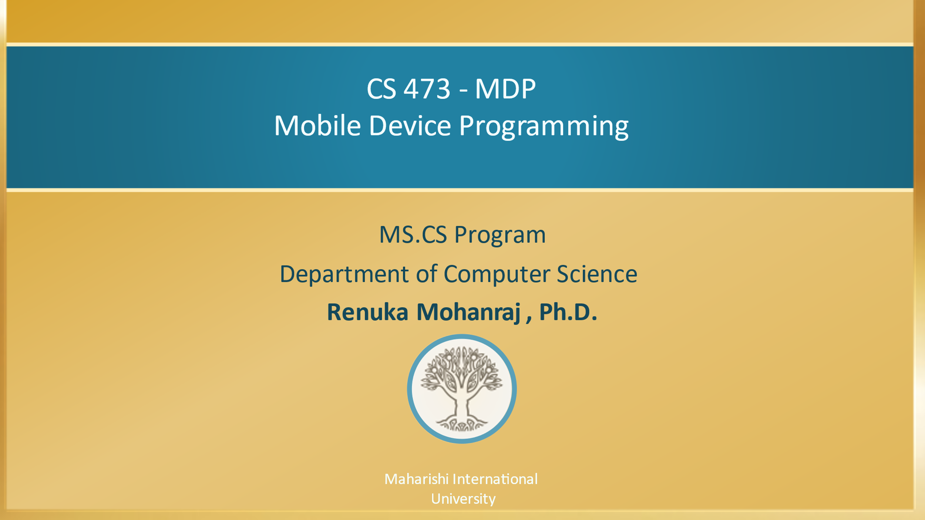

Slide 3

BALA template #10
CS 473 – MDP
Mobile Device Programming
Lesson 5
Intents
Maharishi International
University

Slide 4
Wholeness
In this lesson we will examine the usage of intents. An intent is a communication bridge between app component (activity, service or broadcast) via the android system to perform actions. You can also use intents return information to your original activity. With the help of Transcendental one can communicate easily with inner self like how Android can communicate from one activity to another activity to perform actions with the help of Intents.

Slide 5
Agenda
Activities
Implicit intents
Explicit intents
Hands on example
Explicit event - send a message from one activity to another activity.
Implicit event – sending message through e-mail, dial up screen and WhatsApp
Intent Filters
Getting result from the activity

Slide 6
ACTIVITY & Intent
An Activity is an application component
First activity user sees is typically called “Main activity"
To implement new activities
Define layout in XML
Define Activity Kotlin class
extends AppCompatActivity
Connect Activity with Layout
Set content view in onCreate()
Declare Activity in the Android manifest
An Intent is a messaging object used to request an action from another app component (activity, service or broadcast) via the android system.
An Intent can be used to:
start an Activity
start a Service
deliver a Broadcast

Slide 7
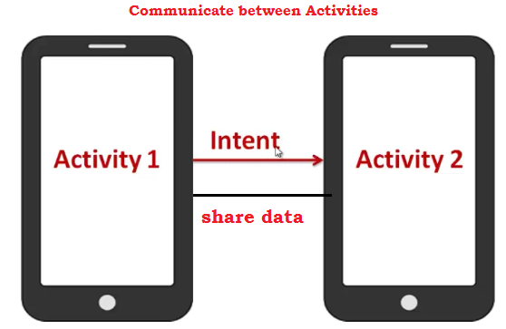
Introduction to Intents
We’re going to show you how to build apps with multiple activities, and how you can get your apps talking to each other using intents.
Intents are multi-purpose communication tools, and the Intent class provides different constructors depending on what you are using the intent to do.

Slide 8
Types of intents
Explicit intents[user defined] specify the component to start by name (the fully-qualified class name). You'll typically use an explicit intent to start a component in your own app, because you know the class name of the activity or service you want to start. For example, you can start a new activity in response to a user action or start a service to download a file in the background.
Implicit intents[API] An implicit intent allows you to start an activity in another app by describing an action you intend to perform, such as "share an article", "view a map", or "take a picture“. An implicit intent specifies an action and may provide data with which to perform the action. Implicit intents do not specify the target activity class, just the intended action.
Intents are created using Intent class. Following are the major methods in Intents class.
setAction() setData() putExtra()
setComponent() setType() getExtra()

Slide 9
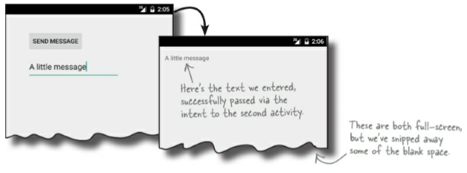
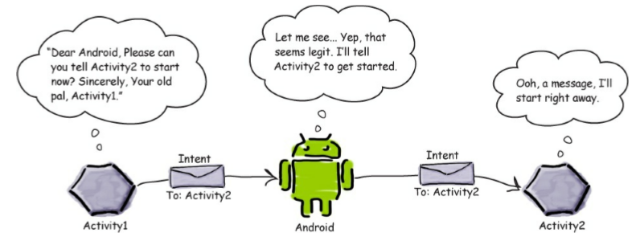
Hands on Example 1 – Explicit Intent
Problem : Send a message from one activity to another activity.

Slide 10
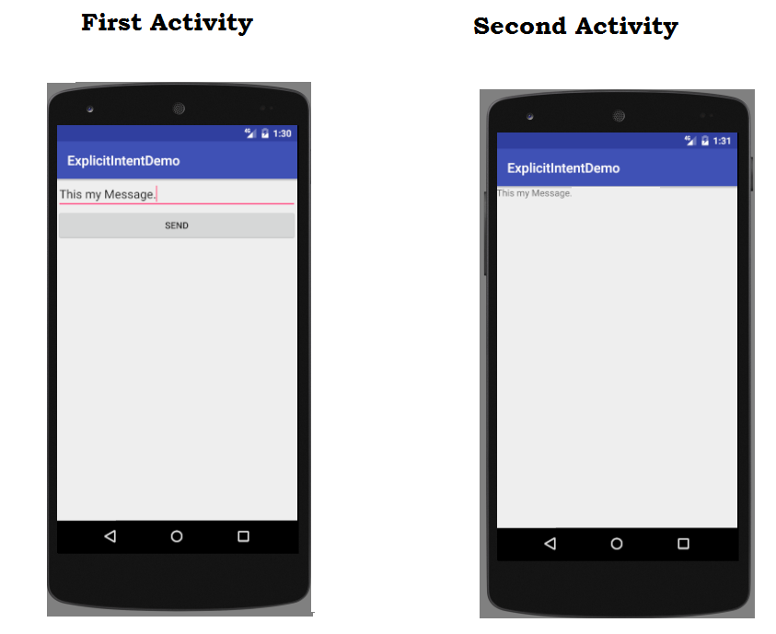
Problem Requirement
Need to Send a message from First Activity to Second Activity using Explicit Intent.

Slide 11
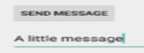
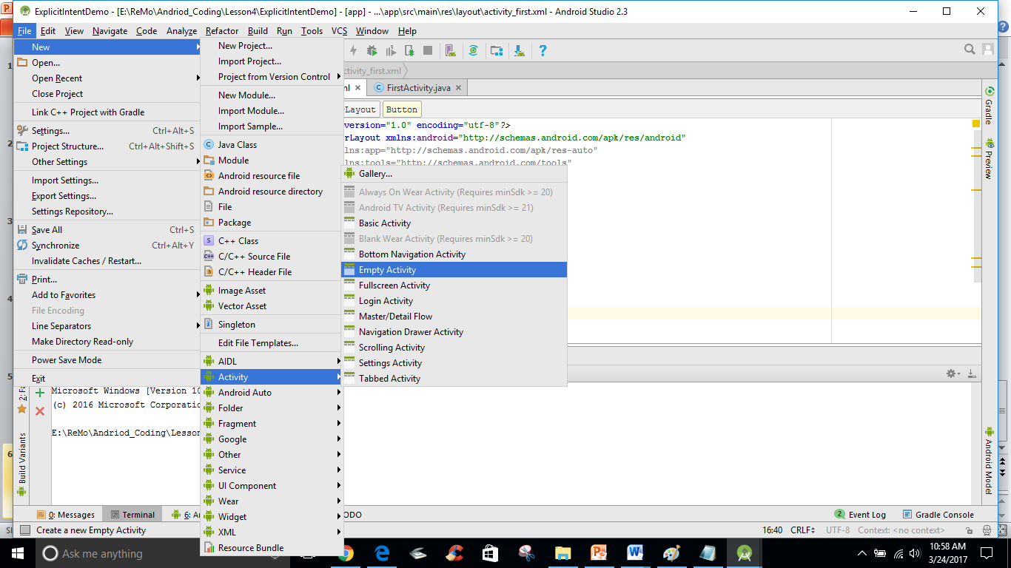
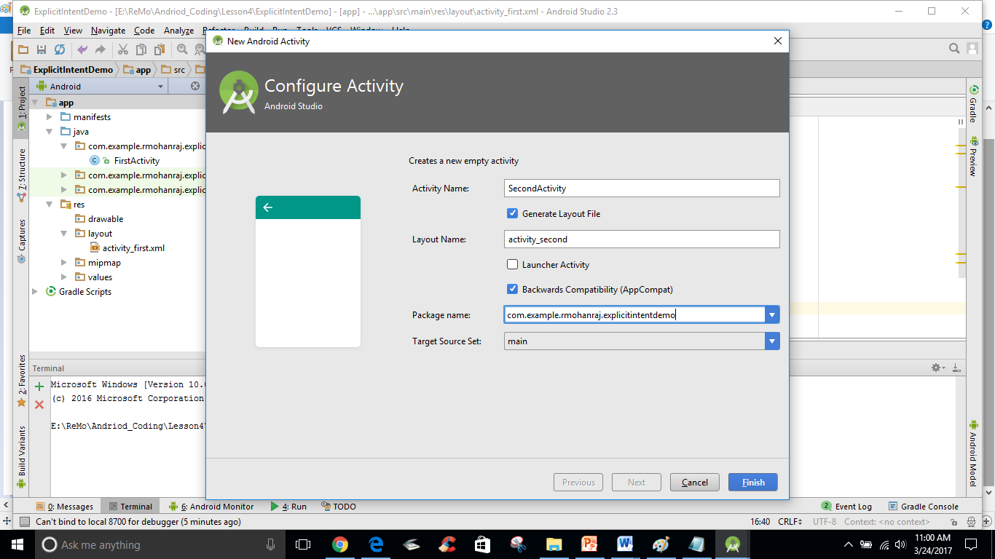
Steps to find the solution
Step 1: Create your first activity with the controls of one text box and one button.
Step 2 : Create a second activity with one Text view to receive message from the first activity in the same project by choosing File→ New → Activity and choose the option for Blank Activity

Slide 12
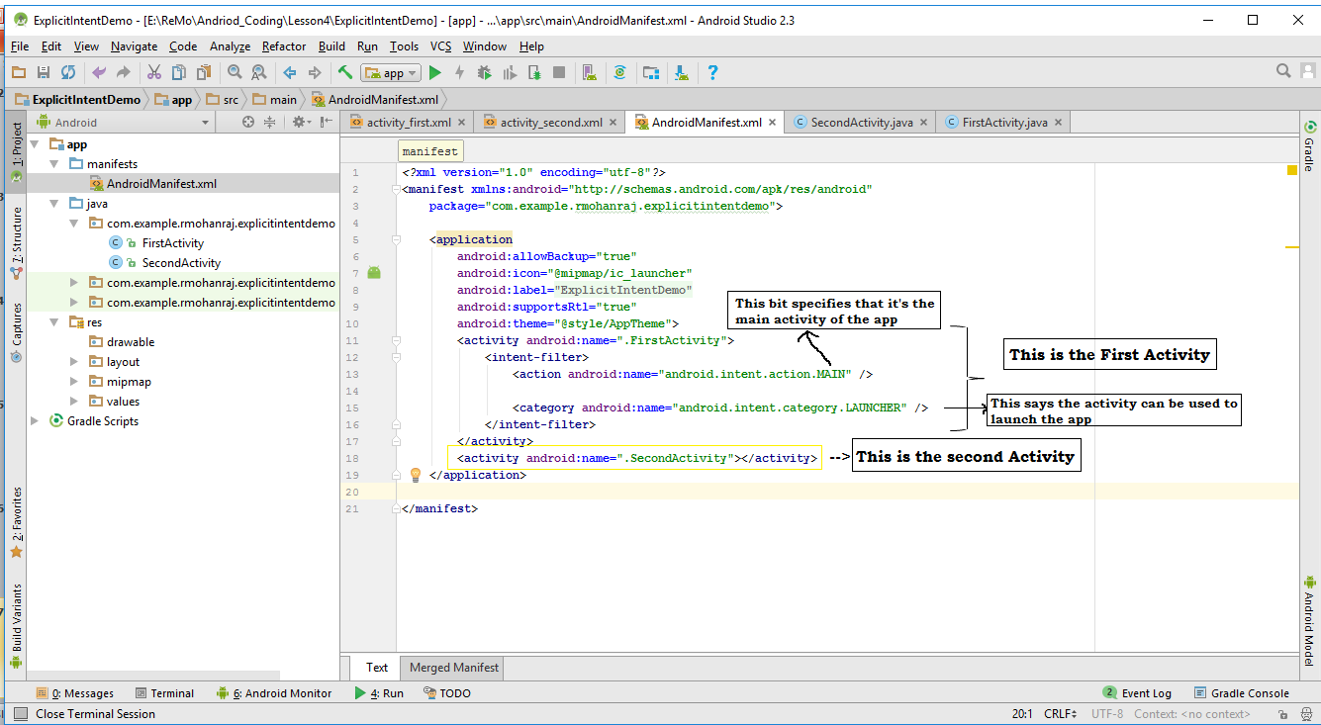
Step : 3 If new activity not configured automatically at AndroidManifest.xml, Configure Second Activity in manifest folder → AndriodManifest.xml and include
<activity android:name=".SecondActivity"></activity> as per the screenshot.

Slide 13
Step : 4 : Create an Intent and StartActivity
You can create and send an intent using just a couple of lines of code. You start by creating the intent like this:
val intent = Intent(this, SecondActivity::class.java)
similar like in java code Intent intent = new Intent(this,TargetClassname.class);
The first parameter tells Android which object the intent is from, and you can use the word this to refer to the current activity. The second parameter is the class name of the activity that needs to receive the intent. Once you’ve created the intent object, you pass it to Android like this:
startActivity(intent);
This tells Android to start the activity specified by the intent. Once Android receives the intent, it checks everything’s OK and tells the activity to start. If it can’t find the activity, it throws an ActivityNotFoundException.
fun onSendMessage(view:View){
var input = smsg.text.toString()
val intent = Intent(this, SecondActivity::class.java)
startActivity(intent)
}

Slide 14
Step 5:Pass text to the Second Activity from the First Activity.
Put the data into the intent as Key/Value pairs. To do this, you use the putExtra() method
intent.putExtra("message", value);
Change the onSendMessge() with putExtra().
fun onSendMessage(view:View){
var input = smsg.text.toString()
val intent = Intent(this, SecondActivity::class.java)
intent.putExtra("message",input ) // Here message is a key to retrieve the input text from the //second activity
startActivity(intent)
}
The putExtra() method is overloaded so value has many possible types. As an example, it can be a primitive such as a boolean or int, an array of primitives, or a String. You can use putExtra() repeatedly to add numerous extra data to the intent. If you do this, make sure you give each one a unique name.

Slide 15
Step 6 : Retrieve extra information from an intent in the Second Activity
There are a couple of useful methods that can help with this. The first of these is getIntent();
getIntent() returns the intent that started the activity, and you can use this to retrieve any extra information that was sent along with it.
How you do this depends on the type of information that was sent.
As an example, if you know the intent includes a string value with a name of “message”, you would use the following:
val intent = getIntent()
val output = intent.getStringExtra("message")
You’re not just limited to retrieving String values. As an example, you can use
int intNum = intent.getIntExtra("name", default_value);
to retrieve an int with a name of name. default_value specifies what int value you should use as a default.

Slide 16
Write this code in the second activity class.
class SecondActivity : AppCompatActivity() {
override fun onCreate(savedInstanceState: Bundle?) {
super.onCreate(savedInstanceState)
setContentView(R.layout.activity_second)
val intent = getIntent()
val output = intent.getStringExtra("message")
rmsg.text = output
}
}
Refer:ExplicitIntentDemo, EmplicitIntentObjectDemo (Share a UserAcocunt Object)

Slide 17
Step 7 : Run your code. After running the app, you will get result as below.

Slide 18
Main Point 1
While creating an Intent object when we explicitly specify and pass on the target component name directly in the intent, it’s an explicit intent. Science of Consciousness: “Wise in the skill of action are those who explicitly first pull the arrow back before they proceed to shoot it ahead. As the mind becomes established in their own consciousness.

Slide 19
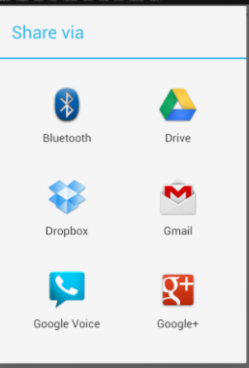
Implicit intents
Implicit intents do not specify the target activity class, just the intended action
Android runtime matches the implicit intent request with registered intent handlers
If there are multiple matches, an app chooser will open to let the user decide
When the android runtime finds multiple registered activities that can handle an implicit intent, it displays an app chooser to allow the user to select the handler.

Slide 20
Implicit Intents - Examples
Java Code
Show a web page
Uri uri = Uri.parse("http://www.google.com");
Intent it = new Intent(Intent.ACTION_VIEW,uri);
startActivity(it);
Dial a phone number
Uri uri = Uri.parse("tel:8005551234");
Intent it = new Intent(Intent.ACTION_DIAL, uri);
startActivity(it);
Open a Map
// Iowa latitude and longitude
Uri uri = Uri.parse("geo:41.8780,93.0977");
Intent it = new Intent(Intent.ACTION_VIEW,uri);
startActivity(it);
Kotlin Code
Show a web page
val uri = Uri.parse("http://www.google.com");
val it = Intent(Intent.ACTION_VIEW,uri);
startActivity(it);
Dial a phone number
val uri = Uri.parse("tel:8005551234");
val it = Intent(Intent.ACTION_DIAL, uri);
startActivity(it);
Open a Map
// Iowa latitude and longitude
val uri = Uri.parse("geo:41.8780,93.0977");
val it = Intent(Intent.ACTION_VIEW,uri);
startActivity(it);
Notes:
Uniform Resource Identifier. creates a new Uri object from a properly formatted String. URI identifies a resource either by location, or a name, or both.

Slide 21
Avoid exceptions and crashes
Before starting an implicit activity, use the package manager to check that there is a package with an activity that matches the given criteria.
Example
Intent intent = new Intent(Intent.ACTION_DIAL);
intent.setData(Uri.parse("tel:8005551234"));
if (intent.resolveActivity(getPackageManager()) != null) {
startActivity(intent);
}

Slide 22
Hands on Example 2 – Implicit Intent
However, you can also start up activities from the API or third-party apps. In those cases, though, you will not have specific Intent object representing the other activity in your project, so you cannot use the Intent constructor to initiate.
Instead, you will use what are referred as the “Implicit” Intent structure.
Let's enhance the previous example by introducing implicit intents to perform the following.
Sending message to the person through Email
Showing a Dial screen App (Intent.ACTION_DIAL)
Showing a WhatsApp App

Slide 23
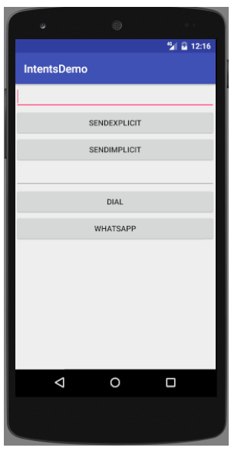
Design Screen
Refer : IntentsDemo
Shows both Explicit and Implicit

Slide 24
Implicit intent to send message
XML Code for the Button SendImplicit
<Button
android:layout_width="match_parent"
android:layout_height="wrap_content"
android:id="@+id/send2"
android:onClick="onSendMessageImplicit"
android:text="SendImplicit"/>
Kotlin Code for the Button Click Event
fun onSendMessageImplicit(view: View) {
var input = smsg.text.toString()
val intent = Intent()
intent.action = Intent.ACTION_SEND
intent.type = “text/plain"
intent.putExtra(Intent.EXTRA_TEXT, input)
startActivity(intent)
}
The intent specifies an action of ACTION_SEND, and a MIME type of text/plain.
Notes:
Multi-Purpose Internet Mail Extensions is an extension of the original Internet e-mail protocol that lets 3protocol to exchange different kinds of data files on the Internet.
PLAIN_TEXT_TYPE ("text/plain")
"image/*“ accepts any type of image or with specific type like “image/jpeg”
"video/*“ accepts any type of Video (specific type mp4,wav)

Slide 25
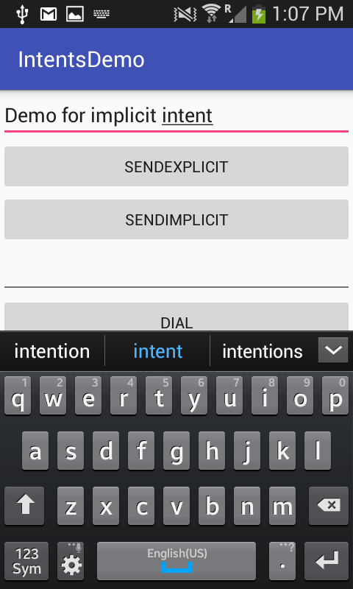
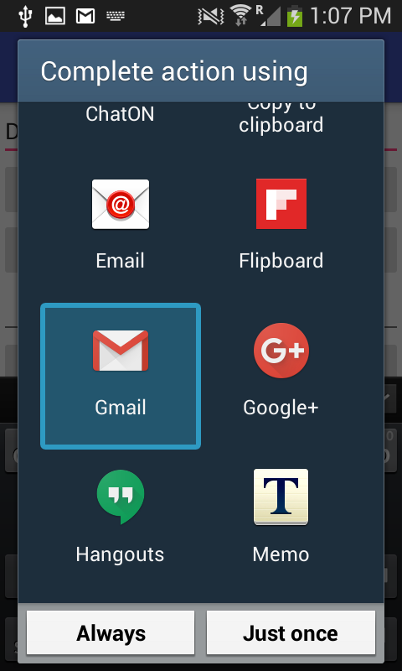
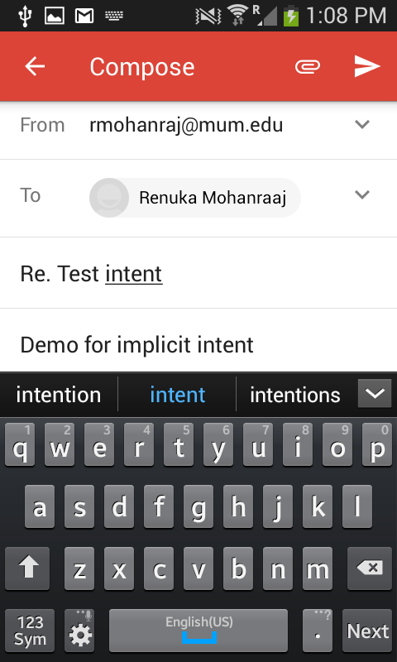
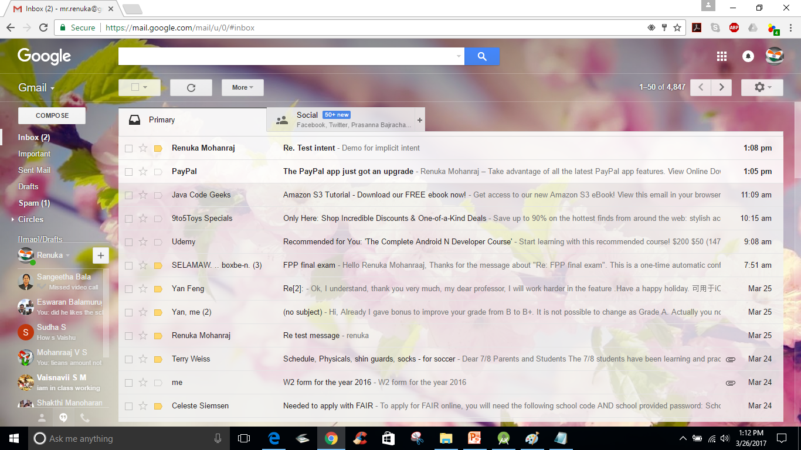
After clicking SENDIMPLICIT button

Slide 26
Implicit intent – dial screen
fun dial(view: View) {
val i = Intent()
i.action = Intent.ACTION_DIAL
val et2 = tel.text.toString()
i.data = Uri.parse("tel:" + et2)
startActivity(i)
}
<EditText
android:id="@+id/tel"
android:inputType= " phone"
android:layout_width="match_parent"
android:layout_height="wrap_content" />
<Button
android:layout_width="match_parent"
android:layout_height="wrap_content"
android:id="@+id/dl"
android:onClick="dial"
android:text="Dial"/>
Whenever the user clicks the DIAL button, calling built-in dial screen by invoking Intent.ACTION_DIAL to call number when the application is launched.
To send any data to the built-in activity use setData(), the parameter for this method is Uri component. To get the Uri component use Uri.parse() method which takes the String input along with what type of data we are sending. Here we are sending telephony type of data which accepts number, #, and *. Ordinary number accepts 0-9.
tel : A data representing kind of telephone number.

Slide 27
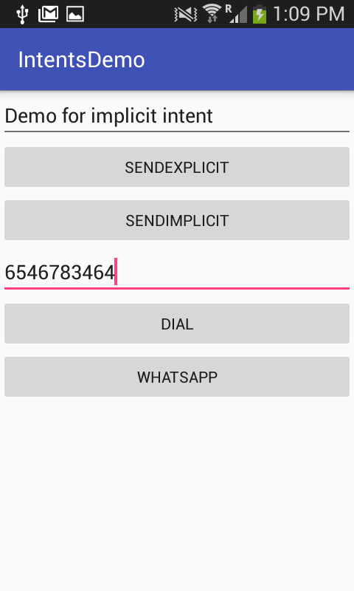
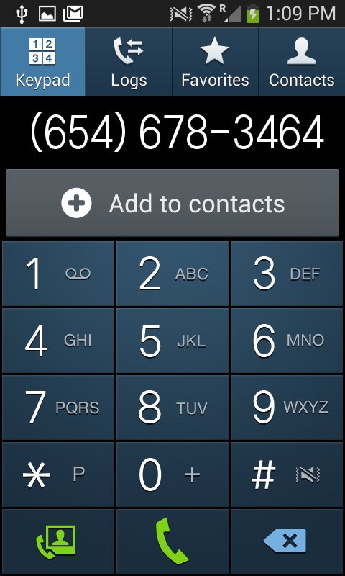
After clicking DIAL button

Slide 28
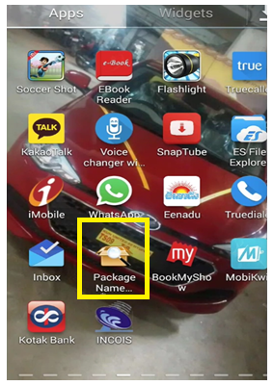
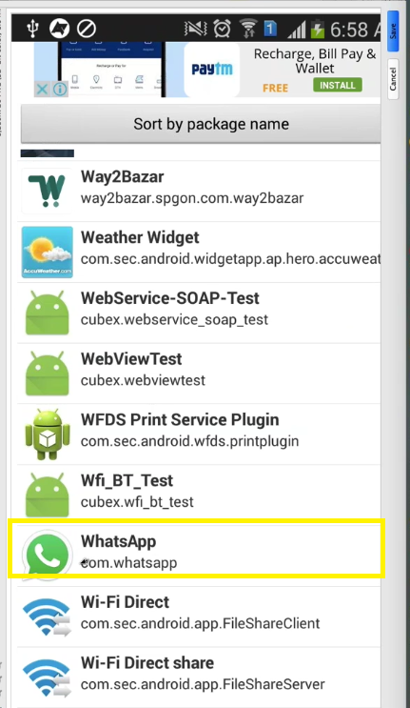
Implicit intent-whatsapp
<Button
android:layout_width="match_parent"
android:layout_height="wrap_content"
android:onClick="whatsapp"
android:text="WhatsApp"/>
fun whatsapp(view: View) {
// To open Third Party app Whatsapp directly
val i = packageManager.getLaunchIntentForPackage
("com.whatsapp")
if(i!=null)
startActivity(i)
else
Toast.makeText(applicationContext,"WhatsApp not installed",Toast.LENGTH_LONG).show()
}
How to know the installed app package name – Method 1
If you want to call any third party application in your logic, first you should get the package name from your App called as PackageNameViewer. If you don’t have the application install the app from play store. Then see package name and use that in the code.

Slide 29
How to know the installed app package name
Method 2
Open play.Google.Com in your web browser.
Use the search bar to look for the app for which you need the package name.
Open the app page and look at the url. The package name forms the end part of the URL i.E. After the id=?. Copy it and use it as needed.
Example https://play.google.com/store/apps/details?id=com.whatsapp

Slide 30
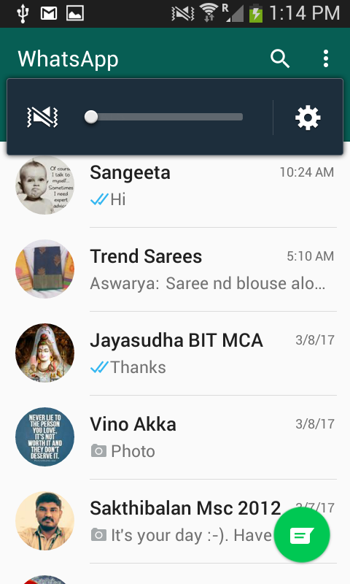
After clicking whatsapp Button

Slide 31
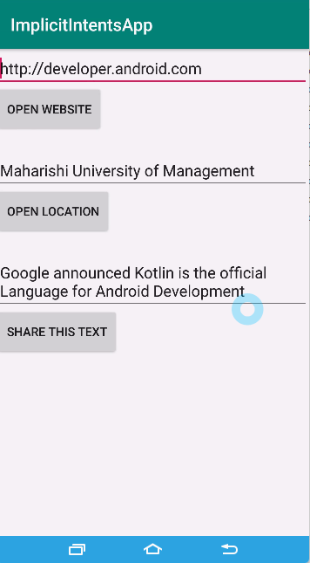
Hands on Example - 3
ImplicitIntentsApp
In this example Share the Text using ShareCompat.IntentBuilder

Slide 32
Frequently used Implicit Intents
Web browser
Email
Alarm clock
Calendar
Camera
Contacts/people app
File storage
Maps
Music or video
Phone
Settings
Text messaging
Refer for complete information : https://developer.android.com/guide/components/intents-common.html

Slide 33
Main Point 2
In implicit intents we delegate the task of evaluating the registered components to Android based on the intent data and the intended action (like send an email, capture a photo, pin location on a map, etc.) that we pass. So, Android will automatically fire up the component from the same app or some other app that can handle the intent message. Science of Consciousness: “Support of Natural Law will render all thought, speech, and action free from stress and strain—life will automatically progress to greater levels of achievement and fulfillment; life will naturally be easy, without problems or failures.

Slide 34
Getting a result back from an activity
Starting another activity, whether one within your app or from another app, doesn't need to be a one-way operation. You can also start another activity and receive a result back.
For example, your app can start a camera app and receive the captured photo as a result. Or you might start the People app for the user to select a contact and you'll receive the contact details as a result.
The activity result apis provide components for registering for a result, launching the result, and handling the result once it is dispatched by the system.
It is strongly recommended to use the activity result apis introduced in AndroidX Activity
A result code specified by the result back activity is either RESULT_OK if the operation was successful or RESULT_CANCELED if the user backed out or the operation failed for some reason.

Slide 35
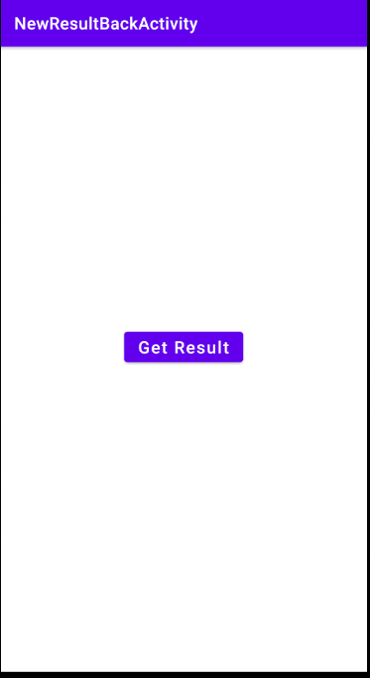
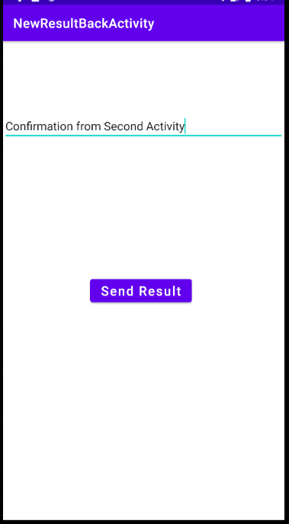
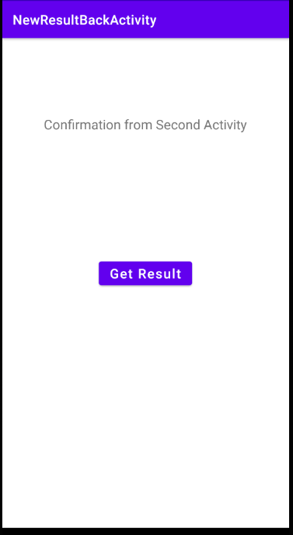
Fetching Result from Second Activity to Main Activity
Activity Main
Activity Second
Activity Main

Slide 36
Fetching the result
In Main activity, write the below code to register for Activity result back.
var resultContracts = registerForActivityResult(ActivityResultContracts.StartActivityForResult()){ result-> // Handle the return result }
Lambda argument result is type of ActivityResult which has the intent, result code such as RESULT_OK or RESULT_CANCEL
registerForActivityResult() takes an ActivityResultContract and an ActivityResultCallback and returns an ActivityResultLauncher which you’ll use to launch the other activity.
To Launch: resultContracts.launch(intent object)
Calling launch()starts the process of producing the result.

Slide 37
Getting a result back from other activity
// Partial Coding part from the MainActivity.java
override fun onCreate(savedInstanceState: Bundle?) {
super.onCreate(savedInstanceState)
setContentView(R.layout.activity_main)
//Retrieve the Result back doing the below step
var resultContracts = registerForActivityResult(ActivityResultContracts.StartActivityForResult()){ result->
if(result.resultCode == Activity.RESULT_OK)
tv.text = result.data?.data.toString()
else
tv.text = "Failed to get Result"
}
btnMain.setOnClickListener {
var intent = Intent(this,SecondActivity::class.java)
resultContracts.launch(intent)
}
}

Slide 38
Getting a result back from a child activity
// Partial Coding part from the SecondActivity.java
override fun onCreate(savedInstanceState: Bundle?) {
super.onCreate(savedInstanceState)
setContentView(R.layout.activity_second)
btnSecond.setOnClickListener {
var result = etext?.text.toString()
val rintent = intent
rintent.data = Uri.parse(result)
setResult(Activity.RESULT_OK, rintent)
finish()
}
}
override fun onBackPressed() {
setResult(Activity.RESULT_CANCELED)
finish()
}
Demo Code : Find the complete code from NewResultBackActivity
Note If you have multiple activity result calls that either use different contracts or want separate callbacks, you can call registerForActivityResult() multiple times to register multiple ActivityResultLauncher instances. You must always call registerForActivityResult()

Slide 39
Intent Filters

Slide 40
Why do you need Intent Filters
To allow other apps to start your activity, you need to add an <intent-filter> element in your manifest file for the corresponding <activity> element.
For example, if you build a social app that can share messages or photos with the user's friends, it's in your best interest to support the ACTION_SEND intent so users can initiate a "share" action from another app and launch your app to perform the action.
When your app is installed on a device, the system identifies your intent filters and adds the information to an internal catalog of intents supported by all installed apps. When an app calls startActivity() or startActivityForResult(), with an implicit intent, the system finds which activity (or activities) can respond to the intent.

Slide 41
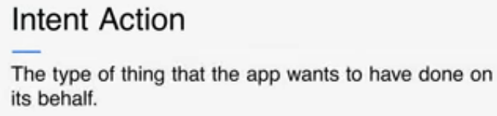
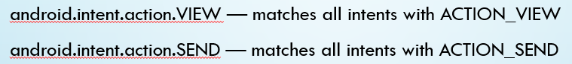
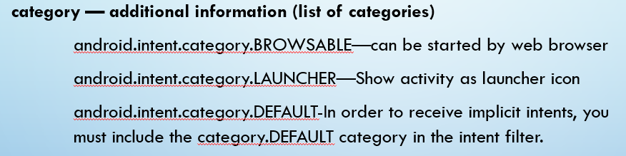
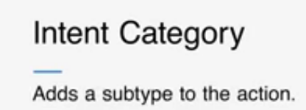
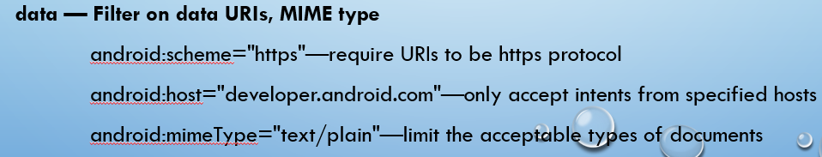
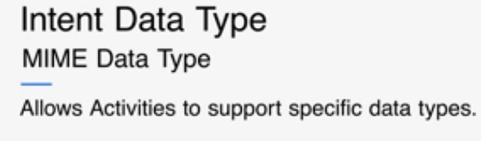
Intent Filters: Action, Category and Data

Slide 42
Registering activity in Manifest
AndroidManifest.xml
<activity android:name=".HelloWorld"
android:label="@string/app_name">
<intent-filter>
<action android:name="android.intent.action.VIEW"/>
<category android:name="android.intent.category.DEFAULT"/>
<category android:name="android.intent.category.BROWSABLE"/>
<data android:scheme="http" android:host="androidium.org"/>
</intent-filter>
</activity>
HelloWorld.kt
val intent = Intent (Intent.ACTION_VIEW,Uri.parse("http://androidium.org"));
startActivity(intent);

Slide 43
An activity can have Multiple filters
<activity android:name=“.ShareActivity">
<intent-filter>
<action android:name="android.intent.action.SEND"/>
...
</intent-filter>
<intent-filter>
<action android:name="android.intent.action.SEND_MULTIPLE"/>
...
</intent-filter>
</activity>

Slide 44
A filter can have multiple actions & data
<intent-filter>
<action android:name="android.intent.action.SEND_MULTIPLE"/>
<category android:name="android.intent.category.DEFAULT"/>
<data android:mimeType="image/*"/>
<data android:mimeType="video/*"/>
</intent-filter>

Slide 45
Main Point 3
Intent Filters describe what ACTION, DATA, or CATEGORIES that component can handle. It defined inside your Android Manifest file also dynamically registered in code. It says what Intent can be handled by the event. Science of Consciousness: Through regular practice of TM, Thought leads to action, action leads to achievement in daily activities, and achievement leads to fulfillment.

Slide 46
